Slide 1
COVID19 Tweet Analysis Demo
Haolan Mai

Slide 2
Target Audience :
Primary Objective :
Assumptions :
Suppose we are a data analytics service provider for the Centers for Disease Control and Prevention (CDC) or a different public health organization.
Gain insight into public sentiment, misinformation, and key topics of discussion surrounding COVID-19
Help tailor communication strategies and public health campaigns more effectively.
Our team works with an analyst at the health organization. They have data analyst skills, but is not an expert in machine learning.

Slide 3
Our modeling approach :
High-Level Model Summary
Our modeling approach has four main steps to it:
Convert all the tweet text to numbers representing the different words/tokens. These are called word embeddings
Use a clustering model to group the tweets together into 8 different categories, based on the content of the tweet.
Use a version of ChatGPT to sample 50-100 tweets from each cluster and describe the tweet using 5-10 keywords
Now, we have a list of 40 labels
Train a Multioutput classification model to assign labels to each tweet in our dataset.
We trained many types: logistic regression, linear discriminant analysis, multilayer perceptrons, random forests, gradient boosting, etc

Slide 4
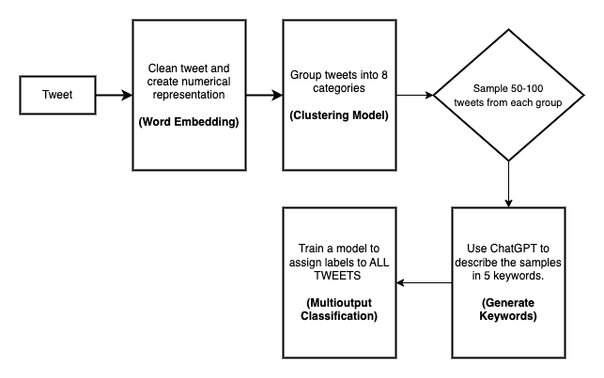
Our modeling approach :

Slide 5
Our modeling approach:
Accuracy: proportion of tweets for which ALL of our keywords are correct
Not a great metric
Hamming Loss: proportion of labels incorrectly assigned
Ex: 0.2 means 80% of labels were correct
Similar to accuracy, but for each label

Slide 6
Modeling Results
Best Model Performance:
95.8% of labels correctly assigned on unseen data.
When using in the future, it is an estimate of how confident you can be in the predictions from the model.

Slide 7
Sample Generated Labels:
social issues, personal development, business and economics, community building
india, updates, testing, fatalities, recoveries, healthcare
face masks, safety, protection, public health, prevention
social media, resilience, community support, online events
global, cases, deaths, statistics
politics, government response, public health, conspiracy, human rights
health, information, vacccine, public awareness
layoffs, misinformation, mental health, lockdown, access, financial impact, political response, education

Slide 8
Demo

Slide 9
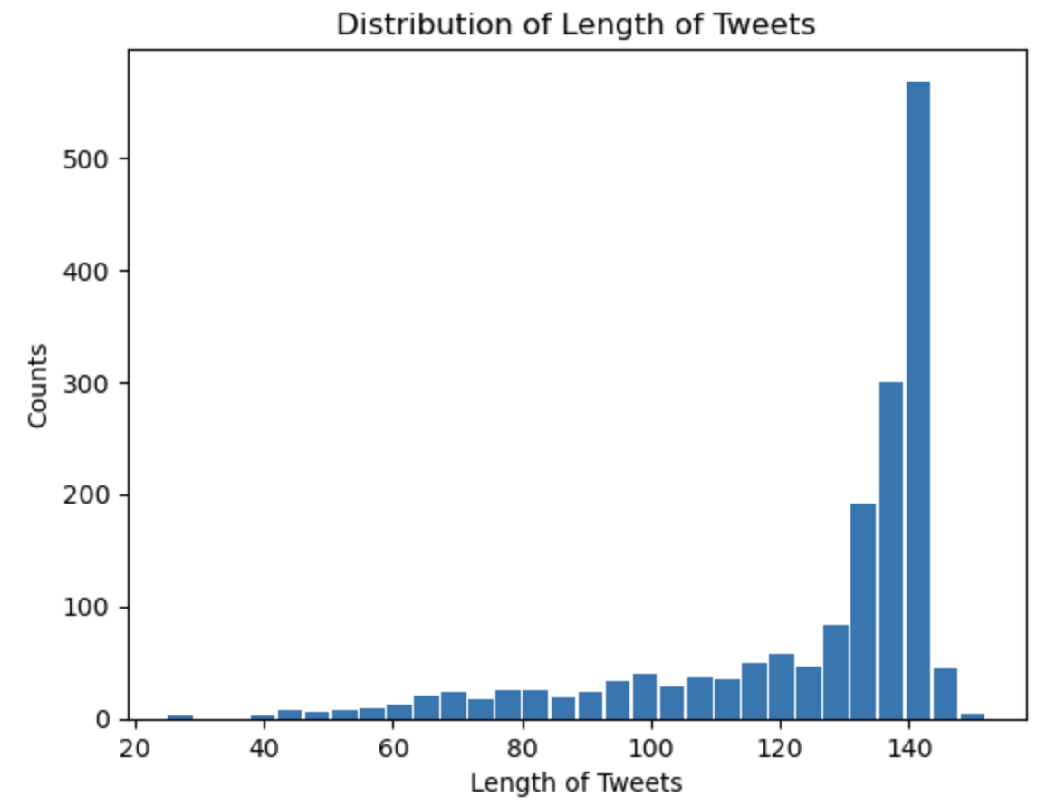
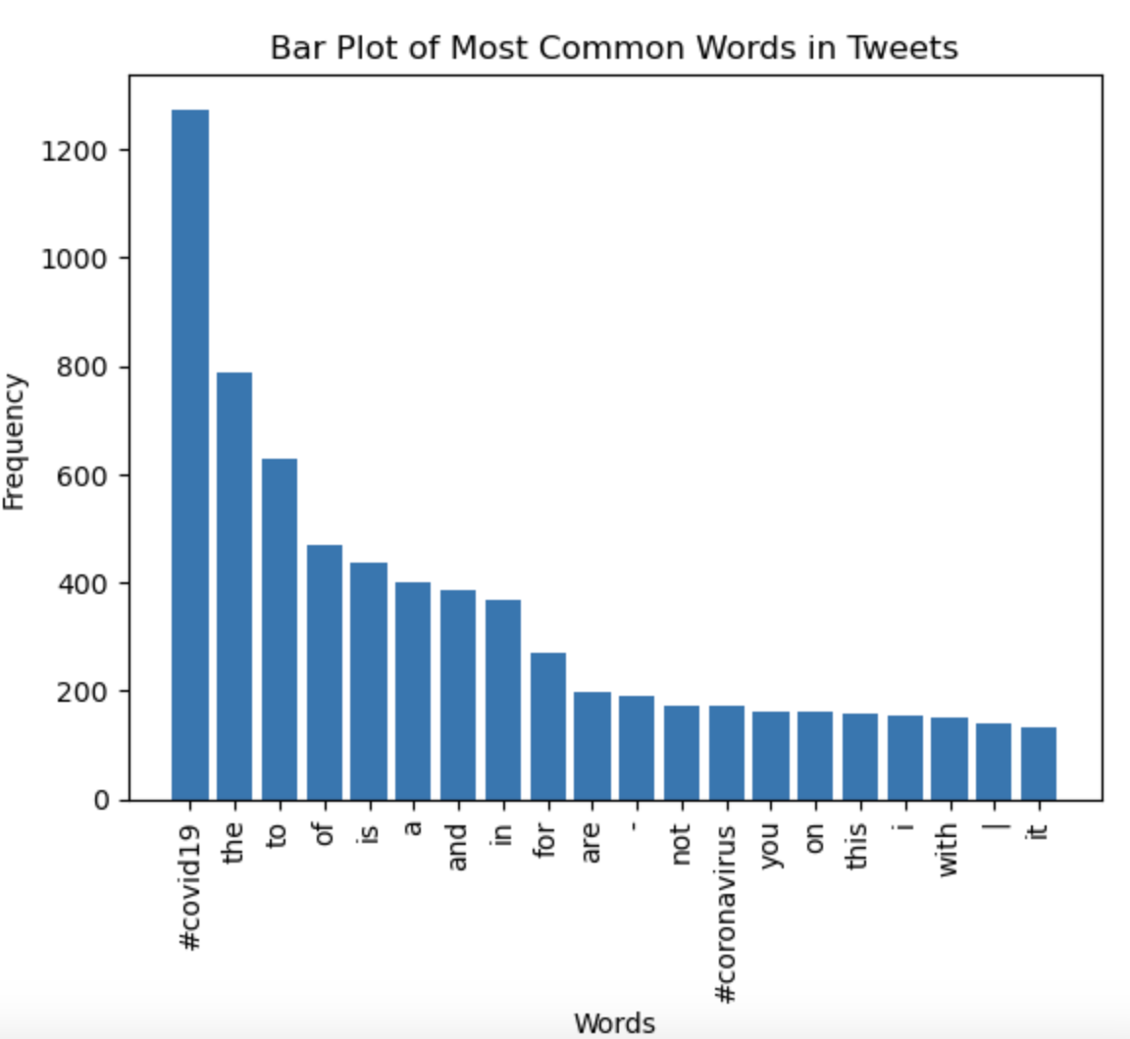
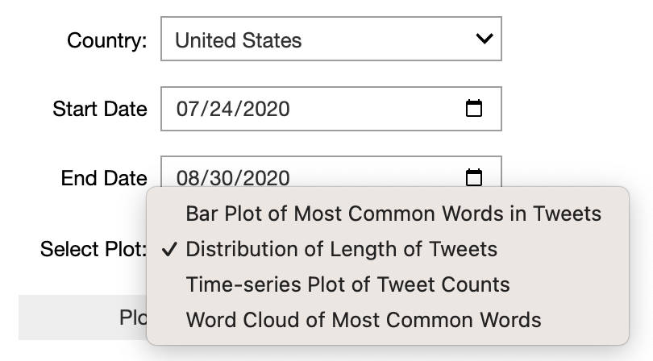
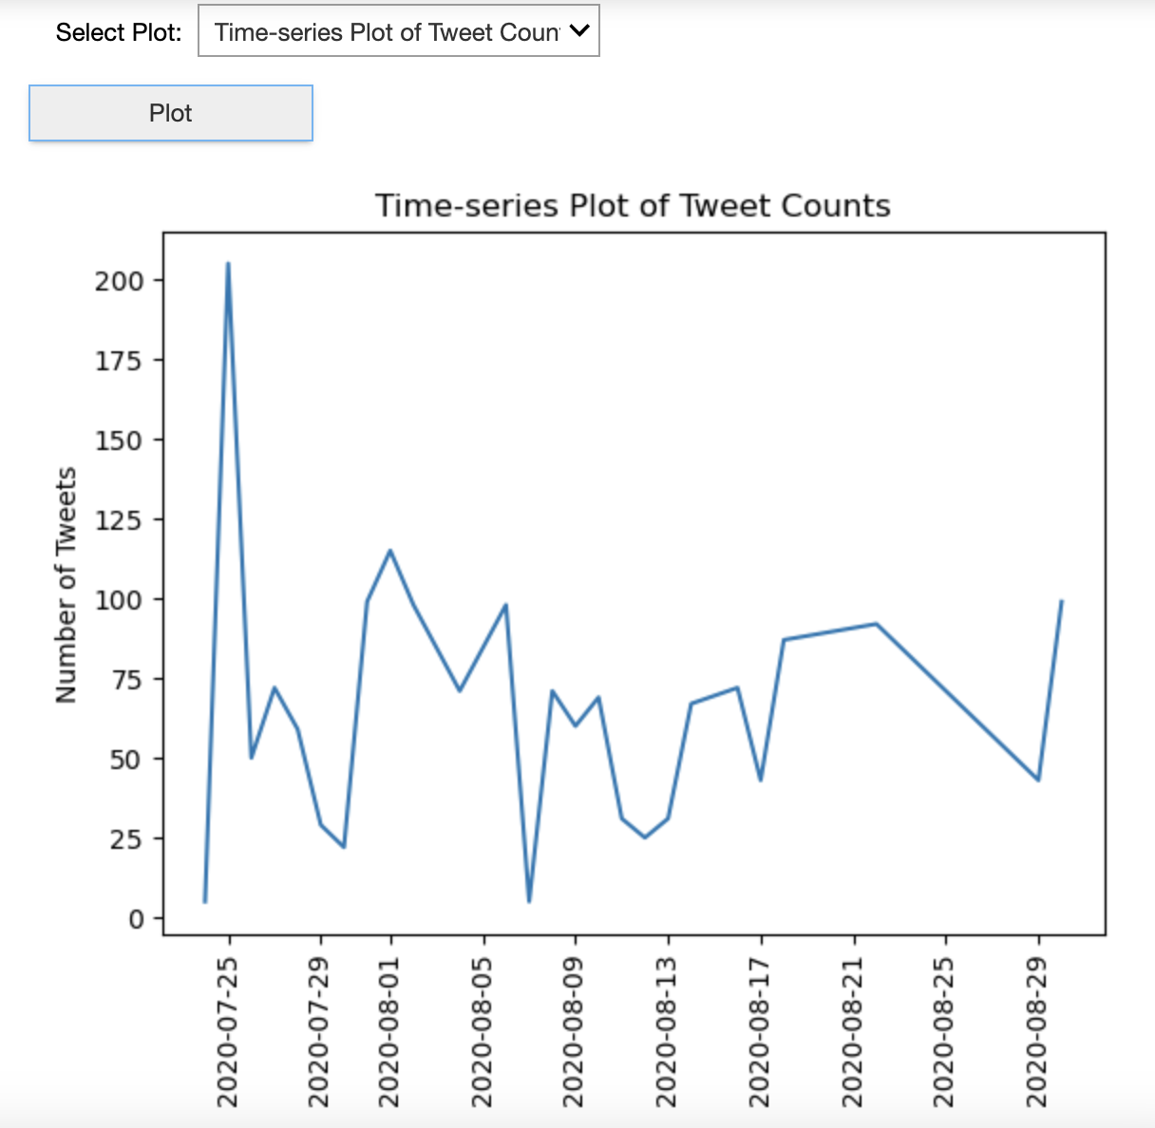
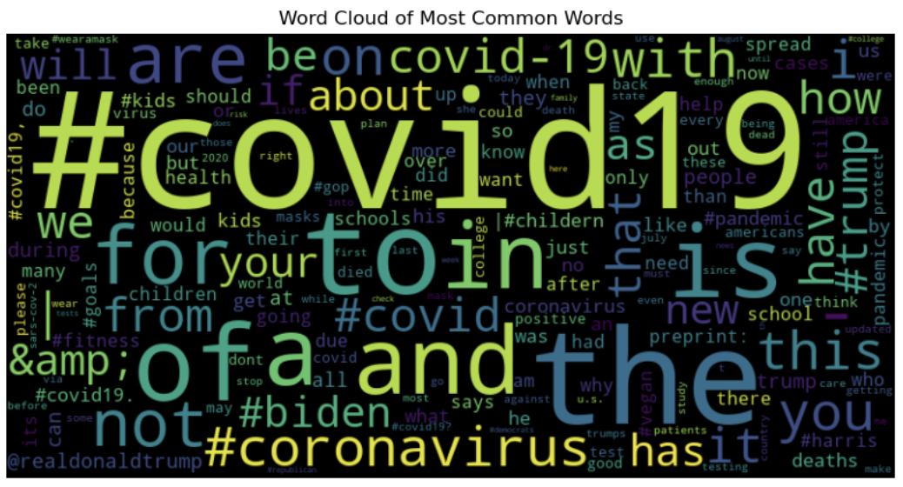
How do target audiences make a decision by demo?
Analyze the distribution of tweet lengths
(the depth of conversation)
Counsel mental health
Analyze how public discussions
Analyze Impact on the number of tweets after countermeasures.

Slide 10
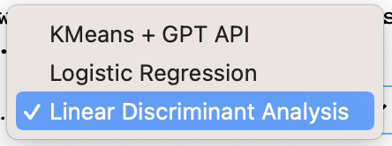
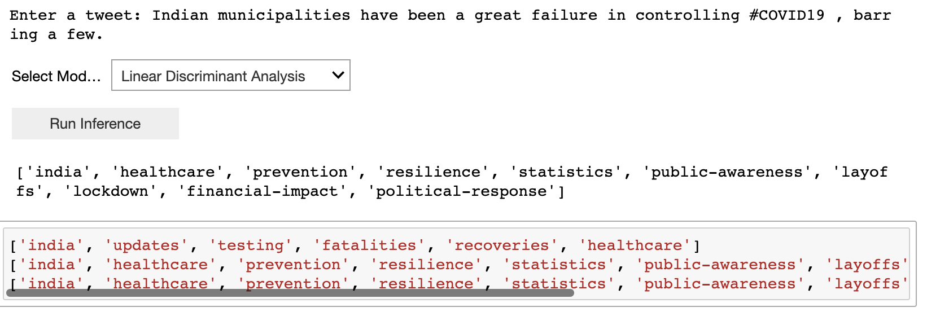
How do target audiences make a decision by demo?
Topic label prediction
The health organization to see trends in individual tweets.

Slide 11
THANKS!

